Slide 1


Minor Project
Title: Loan Approval Prediction
Presented by:
Ritik Rai 500105453
Aaron Singh 500105275
Raghav Jain 500107214
Guided by: Dr. Surpreet Singh

Slide 2
Content
Abstract
Introduction
Literature Review
Problem Statement
Objective
Methodology
Pert Chart
Conclusion
9. References

Slide 3
1. Abstract
The Loan Approval Prediction System is a web-based tool that predicts loan approval outcomes using machine learning. It automates the initial screening process based on financial parameters like income, credit score, and debt-to-income ratio. Using models like Decision Tree and Random Forest, it classifies applications as Approved, Approved with Conditions, or Rejected.
The system features a user-friendly interface, dynamic threshold settings, and feature importance visualization for better decision-making. It ensures data security and compliance with financial regulations. Scalable and efficient, it streamlines loan approvals for applicants, banks, and analysts, reducing processing time and improving accuracy.

Slide 4

2. Introduction
Loan approval is a crucial process in financial institutions, requiring a balance between risk assessment and customer satisfaction. Traditionally, loan approvals are based on fixed criteria and manual evaluations, which can be time-consuming and prone to bias. Machine learning techniques, particularly decision trees, offer a systematic approach to automate and improve decision-making. This project proposes a Decision Tree-Based Loan Approval System that evaluates loan applications based on multiple financial parameters, ensuring faster, more reliable, and unbiased loan approvals. The system also provides an interactive user interface, risk analysis, and visual explanations to make the decision-making process transparent and interpretable.

Slide 5
3.Literature Review
The literature review provides an overview of existing research, methods, and technologies related to decision tree algorithms and loan approval systems. This section helps establish the theoretical foundation of the project by examining prior studies and identifying gaps that this project aims to address.
Decision Tree Algorithms: Various studies highlight the efficiency of decision trees in classification problems, particularly in risk assessment and financial decision-making. Decision trees have been used in credit scoring models, proving their reliability in predicting default risks.
Loan Approval Systems: Traditional loan approval methods rely on predefined rules, whereas modern approaches use machine learning techniques to analyse historical data and improve accuracy.
Feature Importance & Explainability: Research has shown that explainable AI models, such as decision trees, provide clear reasoning for their predictions, making them preferable in financial applications where transparency is crucial.
Optimization Techniques: Performance optimization in decision trees includes pruning techniques, feature selection methods, and parallel processing to improve computation time and accuracy.

Slide 6

4. Problem Statement
The traditional loan approval process is often time-consuming, inconsistent, and prone to human bias. Manual assessments by financial institutions can lead to delays, inefficiencies, and potential errors in evaluating a borrower's eligibility. Additionally, applicants may lack clarity on their approval chances before applying, leading to unnecessary rejections and credit score impacts.
To address these challenges, this project aims to develop an automated Loan Approval Prediction System that leverages machine learning models to predict loan approval outcomes accurately. The system will analyze key financial factors, provide real-time predictions, and offer a user-friendly web interface where applicants can check their eligibility instantly.
This solution will help banks streamline their approval process, reduce manual workload, and enhance decision-making accuracy, ultimately benefiting both lenders and borrowers.

Slide 7

5. Objectives
The primary objective of this project is to design and develop a Decision Tree-Based Loan Approval System that:
Automates loan approval decisions based on applicant attributes.
Implements feature importance analysis to identify key factors influencing approvals.
Allows dynamic threshold customization for adjustable loan policies.
Provides risk scoring to assess loan approval probability.
Implements visualization techniques for decision tree representation.
Ensures scalability and efficiency using optimized algorithms.
Enhances transparency with explainable decision paths.

Slide 8
6. Methodology
Data Collection & Preprocessing
Decision Tree Implementation
Feature Importance Analysis
Custom Rules & Dynamic Thresholds
Risk Scoring Module
Model Evaluation & Cross-Validation
Visualization
Performance Optimization
User Interface
Testing & Deployment

Slide 9
For Web Interface
1 Understanding the Problem
Define how users will interact with the system.
Identify all required input fields (e.g., Income, Credit Score, Loan Amount, etc.).
Define output categories (Approved, Approved with Conditions, Rejected).
2. Backend Development
Tech Flask:
Flask
API
3. Frontend Development
Tech Stack:
Streamlit
React.js + Flask

Slide 10
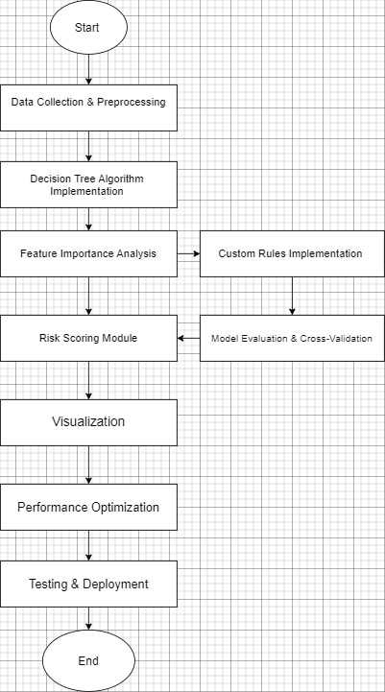
7. PERT Chart

Slide 11

8. Conclusion
This project demonstrates how Decision Trees can enhance loan approval efficiency. By incorporating explainability, risk scoring, and optimization techniques, it provides a robust, scalable, and transparent solution for financial institutions.

Slide 12
9. References
GeeksforGeeks. “Decision Tree Algorithm: An Introduction”.
Kaggle. “Loan Approval Datasets”.
Machine Learning Mastery. “How to Implement Decision Trees in Machine Learning”.
RapidCSV Library for C++ CSV Parsing.

Slide 13
Thank You

